Slide 1

AWS Cloud Practitioner by amazon
Submitted by:
Gautam Kumar Mahato
20BCE2926

Slide 2
Contents
Introduction
About the certification
Aims &Objectives
Motivation
Modules covered
Certificate
Score report
Conclusion

Slide 3
INTRODUCTION
I am excited to share with you my recent achievement in obtaining the AWS Cloud Practitioner certification. This certification is a testament to my dedication to advancing my knowledge and skills in the areas of aws cloud servers, cloud storage, cloud security and many more within the AWS ecosystem.
In this presentation, I will provide an overview of what this certification entails, why it holds significant importance in the field of IT, and how it contributes to enhancing the growth of the IT Industry.

Slide 4

About the Certification:
The AWS Certified Cloud Practitioner course is an entry-level certification offered by Amazon Web Services (AWS) designed for individuals who want to gain foundational knowledge of AWS cloud services and solutions.
This course serves as a stepping stone for those who are new to cloud computing and AWS, helping them establish a strong understanding of key concepts and services in the AWS ecosystem.
This course provides a foundational understanding of AWS cloud concepts, services, and the essential principles needed to work with AWS effectively.

Slide 5
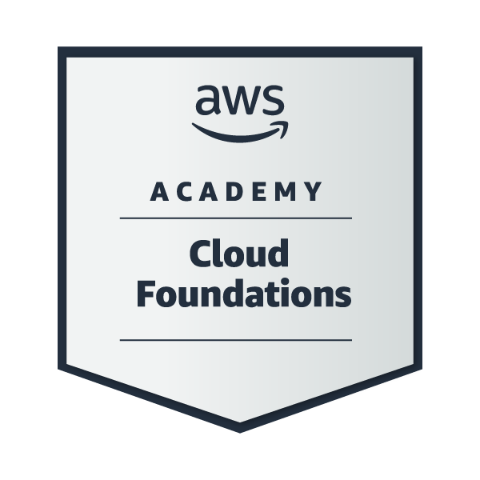
AWS Cloud Practitioner Badge

Slide 6
Aim & Objectives
The aim of the AWS Certified Cloud Practitioner course is to provide individuals with a foundational understanding of Amazon Web Services (AWS) and cloud computing concepts. This course is designed to achieve several key objectives:
1. Introduction to AWS: The course aims to familiarize participants with the AWS platform, its services, and its global infrastructure. It provides an overview of AWS's history, growth, and significance in the cloud computing industry.
2. Fundamental Cloud Concepts: Students are expected to gain a clear understanding of essential cloud computing concepts, such as on-demand resources, scalability, elasticity, and the pay-as-you-go pricing model that underpins cloud services.
3. AWS Service Knowledge: The course's primary goal is to educate participants about key AWS services and their use cases. It covers services like Amazon EC2, Amazon S3, Amazon RDS, AWS Lambda, and others, ensuring students know what these services are and how they work.

Slide 7
objectives
4.Security and Compliance: Understanding AWS's security and compliance measures is a crucial aim. Students should learn how to secure AWS resources, manage access with IAM, and comprehend basic security best practices.
5.Architectural Principles: The course teaches students architectural best practices for designing scalable, highly available, and cost-effective solutions on AWS.
6.Billing and Pricing: Participants should gain knowledge of AWS billing and pricing models, cost management tools, and how to control costs to make informed decisions about AWS usage.
7.Basic Troubleshooting: The course equips individuals with fundamental troubleshooting skills, enabling them to identify and address common issues that may arise while using AWS services.
8.Preparation for Certification: Ultimately, the AWS Certified Cloud Practitioner course aims to prepare participants for the AWS Certified Cloud Practitioner certification exam. This certification validates their understanding of AWS services and cloud computing principles.

Slide 8

Motivation
The motivation behind the AWS Certified Cloud Practitioner course is driven by several factors, each contributing to the value and relevance of the course:
Democratizing Cloud Knowledge
Low Barrier to Entry
Introduction to AWS Ecosystem
Preparation for More Advanced Certifications
Skills Validation
Cost Management and Optimization
Security Awareness
Global Career Opportunities
Evolving Technology Landscape
Empowering Digital Transformation

Slide 9
Modules Covered
Cloud Concepts Overview
Understanding basic Cloud Computing Concepts its advantages
Cloud Economics and Billing
Understanding fundamentals of pricing and Total Cost of OwnerShip
Understanding AWS Billing & Cost Management with Billing DashBoard
AWS Global Infrastructure Overview
Identifying AWS global infrastructure, AWS Services and Service Categories
AWS Cloud Security
Understanding the concepts of Identity and Access Management
Working to Ensure Compliance, Secure Accounts & Secure Data
Networking and Content Delivery
Understanding the basic concepts of Cloud Networking, Amazon VPC and VPC Security

Slide 10
Cloud Compute
Introduction & Demonstration to Amazon Elastic Compute Cloud(EC2) and Amazon EC2 Cost Optimization
Understanding the concepts of Container Services(ECS & EKS)
Introduction to AWS Lambda and AWSElastic Benstalk
Cloud Storage
Introduction & Demonstration of AWS EBS(Elastic Block Store)
Understanding of AWS S3(Simple Storage Service) & EFS(Elastic File System)
Introduction & Demonstration of S3 Glacier
Cloud Database
Introduction & Demonstration of Amazon RDS(Relational Database Service) & Amazon DynamoDB
Introduction & Demonstration of Amazon RedShift & Amazon Aurora
Cloud Architecture
Understanding Well-Architected framework Design Principles
Overview Operational excellence, Security, reliability, efficiency, cost optimization
Auto Scaling and Monitoring
Introduction to Elastic Load Balancing and Amazon CloudFront
Understanding the concepts of Amazon EC2 Auto Scaling

Slide 11
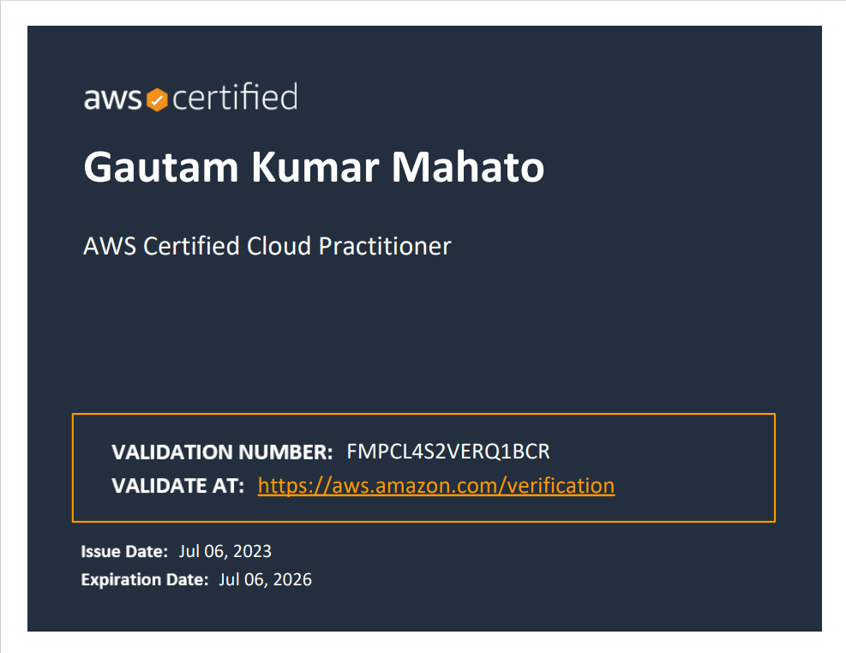
Certificate

Slide 12
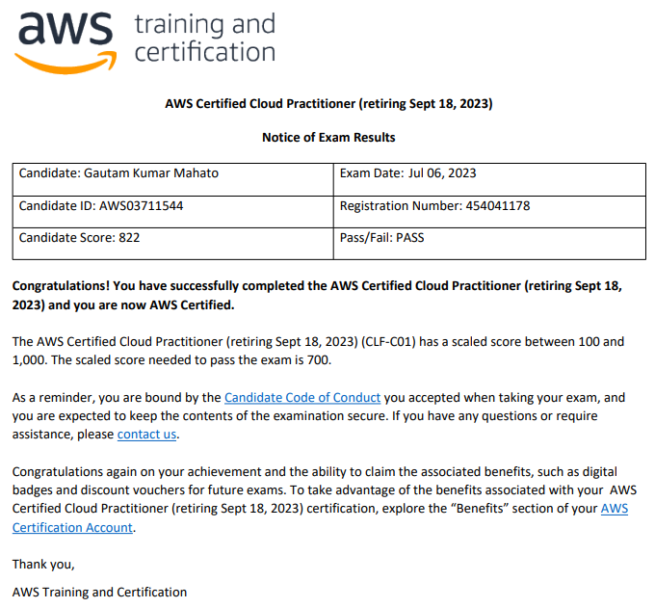
Score report

Slide 13
Conclusion
In conclusion, achieving the AWS Cloud Practitioner certification has been a significant milestone in my professional journey. This certification not only deepened my understanding of Cloud Computing, Cloud security, compliance, and identity management concepts but also equipped me with practical skills to address the evolving challenges in today's IT landscape.
As we've explored, the certification encompasses vital areas such as Cloud Computing, identity management, Cloud Storage Load balancing and more.

